Slide 1
When to use What – Azure Services
Sastry Kolachina
https://www.linkedin.com/in/sastrykn/

Slide 2
Why I created this?
During my discussions with customers and partners, I have been asked many a times to provide better guidance on “When to Use - What Azure Services”.
While most of this information is publicly available, it is spread across the Azure documentation and could be difficult to find.
In this deck, I intend to provide guidance on when to use what products/services/technologies in Azure through the publicly available content with a bit of my flavours and customisation. The areas currently covered are Compute, Storage, Networking, Identity, and Database.
The deck is available at my GitHub repository under MIT license. Feel free to reuse, distribute and add updates to the content.
I plan to update every 3-4 months, however, would require the help of the community to keep this updated, if you find this useful enough :-). Do share your feedback via LinkedIn or GitHub.
GitHub – Please contribute, provide your feedback, suggestions for improvements

Slide 3
Update Log
Last Updated 22 Jan 2021
Reviewed and updated slides for IaaS, updated relevant charts/diagrams
Updated Management, Monitoring and Governance section
New Slides
Slide 6 – (*New) Decision Tree – Identify Compute Service Requirements
Slide 18 – (*New) Cloud Adoption Framework – Networking Decision Tree
Slide 19 – Networking - Updated with latest chart
Slide 24 – (*New) Security - Which Feature to Use to Secure Azure Platform
Slide 26-27 – App Modernization – Selecting Right Cloud Services
Slide 29 – Updated Data Platform Product – When to Use What
Slide 30 – (*New) Data Platform Use Case Scenarios and Comparison
Slide 32 – (*New) Select an Azure data store for your application (Thanks Anil and Husam)

Slide 4
IaaS Decision Making Guide Compute, Network and Storage

Slide 5
Which Compute Product To Use?
If You Want To... | Use This
Provision Linux and Windows virtual machines in seconds with the configurations of your choice | Virtual Machines
Achieve high availability by autoscaling to create thousands of VMs in minutes | Virtual Machine Scale Sets
Simplify the deployment, management, and operations of Kubernetes | Azure Kubernetes Service (AKS)
Accelerate app development using an event-driven, serverless architecture | Azure Functions
Develop microservices and orchestrate containers on Windows and Linux | Service Fabric
Quickly create cloud apps for web and mobile with fully managed platform | App Service
Containerize apps and easily run containers with a single command | Container Instances
Cloud-scale job scheduling and compute management with the ability to scale to tens, hundreds, or thousands of virtual machines | Batch
Create highly available, scalable cloud applications and APIs that help you focus on apps instead of hardware | Cloud Services
Deploy your Azure virtual machines on a physical server only used by your organization | Azure Dedicated Host
https://azure.microsoft.com/en-us/product-categories/compute/

Slide 6
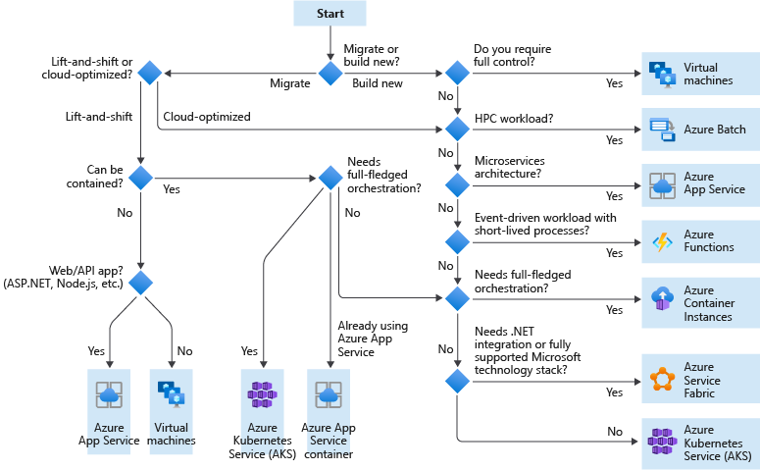
Identify Compute Service Requirements
Notes:
https://docs.microsoft.com/en-us/azure/cloud-adoption-framework/ready/considerations/compute-options
As part of your landing zone evaluation and preparation, you need to identify all compute resources that your landing zone will need to support. This process involves assessing each of the applications and services that make up your workloads to determine your compute and hosting requirements. After you identify and document your requirements, you can create policies for your landing zone to control what resource types are allowed based on your workload needs.
For each application or service you'll deploy to your landing zone environment, use the following decision tree as a starting point to help you determine your compute services requirements:

Slide 7
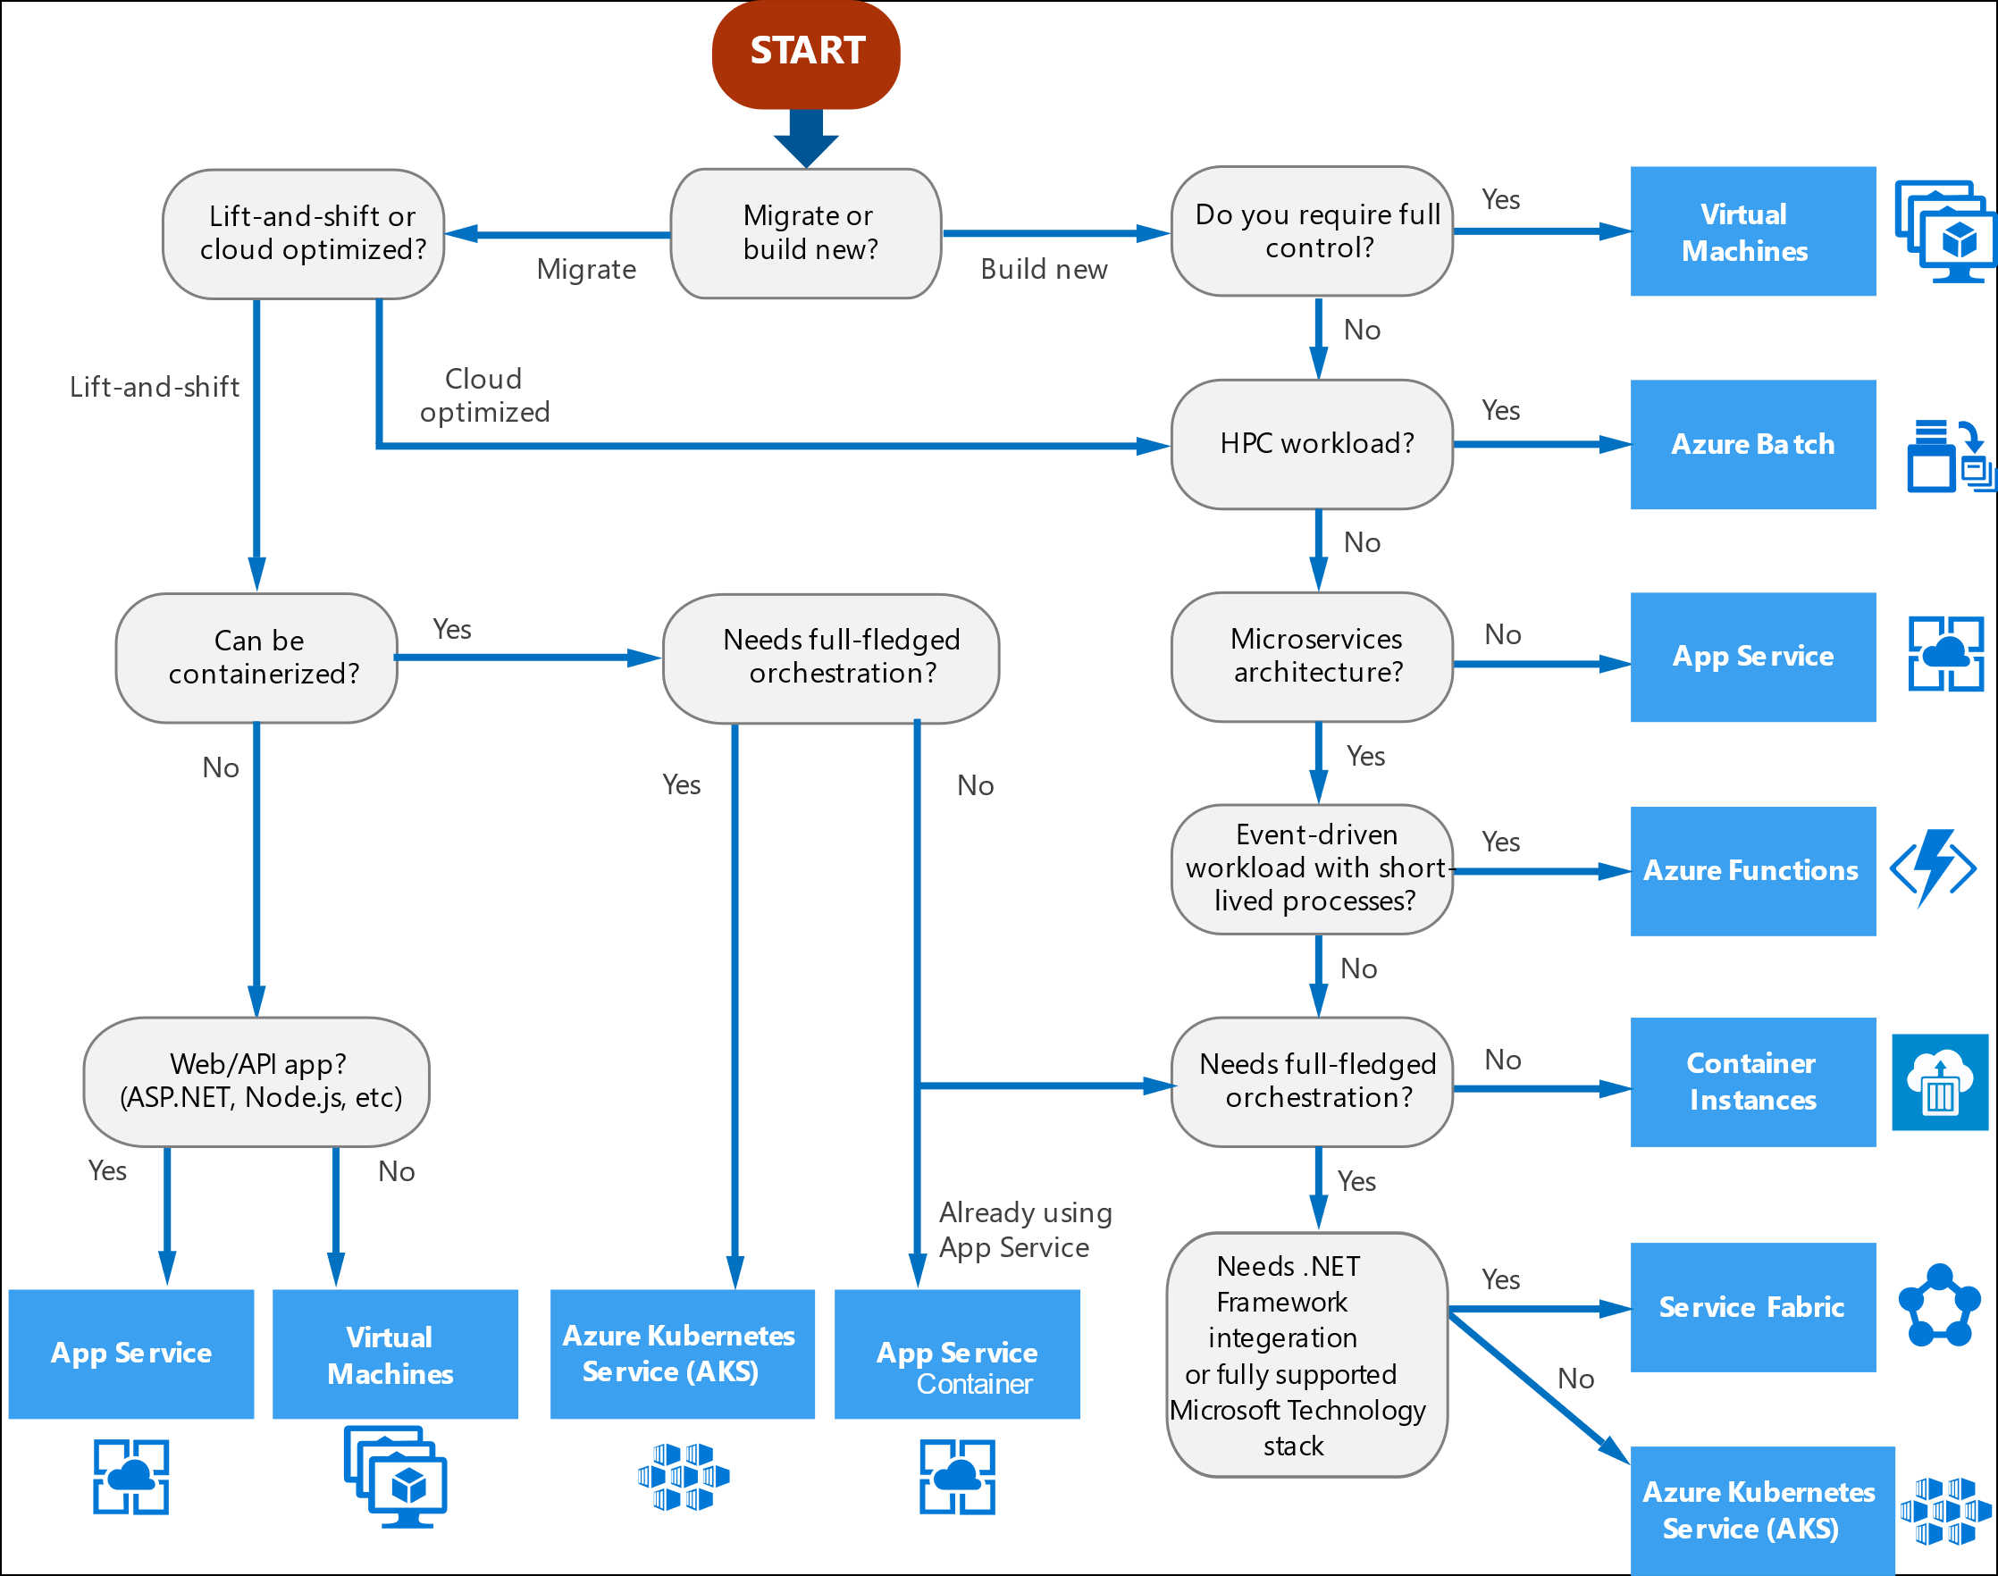
Decision tree for Azure compute services Where to place your workload?
https://docs.microsoft.com/en-us/azure/architecture/guide/technology-choices/compute-decision-tree

Slide 8
Criteria For Choosing An Azure Compute Service (Hosting Model)
Criteria | Virtual Machines | App Service | Service Fabric | Azure Functions | Azure Kubernetes Service | Container Instances | Azure Batch
Application composition | Agnostic | Applications, containers | Services, guest executables, containers | Functions | Containers | Containers | Scheduled jobs
Density | Agnostic | Multiple apps per instance via app service plans | Multiple services per VM | Serverless ¹ | Multiple containers per node | No dedicated instances | Multiple apps per VM
Minimum number of nodes | 1 ² | 1 | 5 ³ | Serverless ¹ | 3 ³ | No dedicated nodes | 1 ⁴
State management | Stateless or Stateful | Stateless | Stateless or stateful | Stateless | Stateless or Stateful | Stateless | Stateless
Web hosting | Agnostic | Built in | Agnostic | Not applicable | Agnostic | Agnostic | No
Can be deployed to dedicated VNet? | Supported | Supported⁵ | Supported | Supported ⁵ | Supported | Not supported | Supported
Hybrid connectivity | Supported | Supported ⁶ | Supported | Supported ⁷ | Supported | Not supported | Supported
https://docs.microsoft.com/en-us/azure/architecture/guide/technology-choices/compute-comparison

Slide 9
Criteria for choosing an Azure compute service (Scalability)
Criteria | Virtual Machines | App Service | Service Fabric | Azure Functions | Azure Kubernetes Service | Container Instances | Azure Batch
Autoscaling | Virtual machine scale sets | Built-in service | Virtual machine scale sets | Built-in service | Not supported | Not supported | N/A
Load balancer | Azure Load Balancer | Integrated | Azure Load Balancer | Integrated | Integrated | No built-in support | Azure Load Balancer
Scale limit¹ | Platform image: 1000 nodes per VMSS, Custom image: 100 nodes per VMSS | 20 instances, 100 with App Service Environment | 100 nodes per VMSS | 200 instances per Function app | 100 nodes per cluster (default limit) | 20 container groups per suscription (default limit). | 20 core limit (default limit).

Slide 10
Criteria for choosing an Azure compute service (DevOps)
Criteria | Virtual Machines | App Service | Service Fabric | Azure Functions | Azure Kubernetes Service | Container Instances | Azure Batch
Local debugging | Agnostic | IIS Express, others ¹ | Local node cluster | Visual Studio or Azure Functions CLI | Minikube, others | Local container runtime | Not supported
Programming model | Agnostic | Web and API applications, WebJobs for background tasks | Guest executable, Service model, Actor model, Containers | Functions with triggers | Agnostic | Agnostic | Command line application
Application update | No built-in support | Deployment slots | Rolling upgrade (per service) | Deployment slots | Rolling update | Not applicable

Slide 11
Which Storage Product To Use?
If You Want To... | Use This
Get scalable and secure storage for your virtual machines | Disk Storage
Find massively scalable, secure storage for your unstructured data | Blob Storage
Get low-cost storage for rarely accessed data | Archive Storage
Get secure cloud file shares | File Storage
Run high-performance, file-based workloads in the cloud | Avere vFXT for Azure
Get secure storage for message-based communication between apps | Queue Storage
Appliances and solutions for data transfer to Azure and edge compute | Data Box
Create powerful file shares for enterprise workloads, including open-source/Linux | Azure NetApp Files
https://azure.microsoft.com/en-us/product-categories/storage/
Notes:
https://azure.microsoft.com/en-us/product-categories/storage/

Slide 12
Azure Storage - Files vs. Blobs vs. Disks
Feature | Description | When to use
Azure Files | Provides an SMB interface, client libraries, and a REST interface that allows access from anywhere to stored files. | You want to "lift and shift" an application to the cloud which already uses the native file system APIs to share data between it and other applications running in Azure. You want to store development and debugging tools that need to be accessed from many virtual machines.
Azure Blobs | Provides client libraries and a REST interfacethat allows unstructured data to be stored and accessed at a massive scale in block blobs. Also supports Azure Data Lake Storage Gen2 for enterprise big data analytics solutions. | You want your application to support streaming and random-access scenarios. You want to be able to access application data from anywhere. You want to build an enterprise data lake on Azure and perform big data analytics.
Azure Disks | Provides client libraries and a REST interfacethat allows data to be persistently stored and accessed from an attached virtual hard disk. | You want to lift and shift applications that use native file system APIs to read and write data to persistent disks. You want to store data that is not required to be accessed from outside the virtual machine to which the disk is attached.
Above table compares Files, Blobs, and Disks, and shows example scenarios appropriate for each

Slide 13
Durability Options for your Storage Needs?
Scenario | Locally redundant storage | Geo-redundant storage | Read Access geo-redundant storage | Zone-redundent storage | Geo Zone Redundant Storage | Read Access Geo Zone Redundant Storage
Node unavailability within a data center | Yes
An entire data center (zonal or non-zonal) becomes unavailable | No | Yes (failover is required) |  | Yes | Yes
A region-wide outage | No | Yes (failover is required) |  | No | Yes (failover is required)
Read access to your data (in a remote, geo-replicated region) in the event of region-wide unavailability | No | No | Yes | No | No | Yes
Designed to provide X% durability of objects over a given year | at least 11 9's | at least 16 9's |  | at least 12 9's | at least 16 9's
Supported storage account types | GPv2, GPv1, Blob |  |  | GPv2
Availability SLA for read requests | At least 99.9% (99% for Cool Access Tier) |  | At least 99.99% (99.9% for Cool Access Tier) | At least 99.9% (99% for cool access tier) |  | At least 99.99% (99.9% for Cool Access Tier)
Availability SLA for write requests | At least 99.9% (99% for Cool Access Tier)
Notes:
https://azure.microsoft.com/en-us/blog/geo-zone-redundant-storage-in-azure-now-in-preview/

Slide 14
Which Networking Product To Use?
If You Want To... | Use This
Connect everything from virtual machines to incoming VPN connections | Virtual Network
Balance inbound and outbound connections and requests to your applications or service endpoints | Load Balancer
Optimise delivery from application server farms while increasing application security with a web application firewall | Application Gateway
Securely use the internet to access Azure Virtual Networks with high performance VPN gateways | VPN Gateway
Ensure ultra-fast DNS responses and ultra-high availability for all your domain needs | Azure DNS
Accelerate the delivery of high-bandwidth content to customers worldwide—from applications and stored content to streaming video | Content Delivery Network
Protect your Azure applications from the impacts of DDoS attacks | Azure DDoS Protection
Distribute traffic optimally to services across global Azure regions, while providing high availability and responsiveness | Traffic Manager
Add private network connectivity to access Microsoft cloud services from your corporate networks, as if they were on-premises residing in your own datacenter | Azure ExpressRoute
Monitor and diagnose conditions at a network scenario level | Network Watcher
Native firewalling capabilities with built-in high availability, unrestricted cloud scalability and zero maintenance | Azure Firewall
Connect business offices, retail locations and sites securely with Virtual WAN, a unified wide-area network portal powered by Azure and the Microsoft global network | Virtual WAN
Scalable, security-enhanced delivery point for global, microservice-based web applications | Azure Front Door
Private and fully managed RDP and SSH access to your virtual machines | Azure Bastion
Private access to services hosted on the Azure platform, keeping your data on the Microsoft network | Azure Private Link
Test how networking infrastructure changes will impact your customers' performance. | Azure Internet Analyzer
https://azure.microsoft.com/en-us/product-categories/networking/

Slide 15
Choose the right Virtual Networking architectures
Question | PaaS-only | Cloud-native | Cloud DMZ | Hybrid | Hub and spoke
Will your workload only use PaaS services and not require networking capabilities beyond those provided by the services themselves? | Yes | No | No | No | No
Does your workload require integration with on-premises applications? | No | No | Yes | Yes | Yes
Have you established mature security policies and secure connectivity between your on-premises and cloud networks? | No | No | No | Yes | Yes
Does your workload require authentication services not supported through cloud identity services, or do you need direct access to on-premises domain controllers? | No | No | No | Yes | Yes
Will you need to deploy and manage a large number of VMs and workloads? | No | No | No | No | Yes
Will you need to provide centralized management and on-premises connectivity while delegating control over resources to individual workload teams? | No | No | No | No | Yes
Notes:
https://docs.microsoft.com/en-us/azure/architecture/cloud-adoption/decision-guides/software-defined-network/index

Slide 16
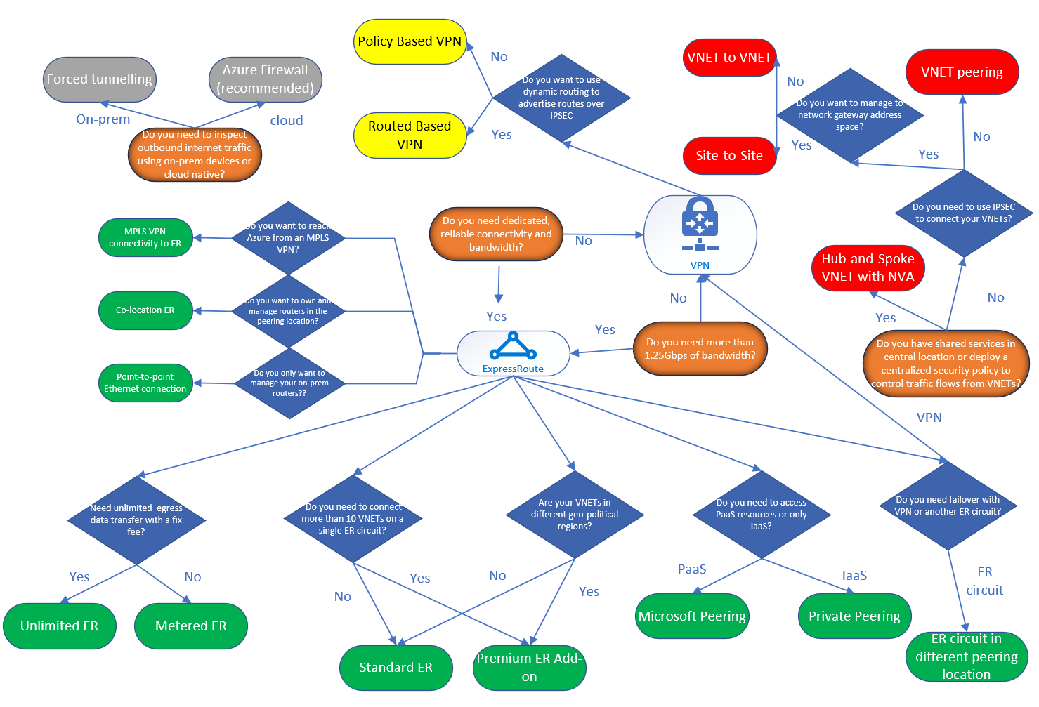
Decision Tree for Azure Networking Solutions
https://blogs.msdn.microsoft.com/ukhybridcloud/2018/09/12/a-decision-tree-for-azure-networking/
Notes:
https://techcommunity.microsoft.com/t5/ITOps-Talk-Blog/What-is-the-difference-between-Azure-Application-Gateway-Load/ba-p/572912

Slide 17
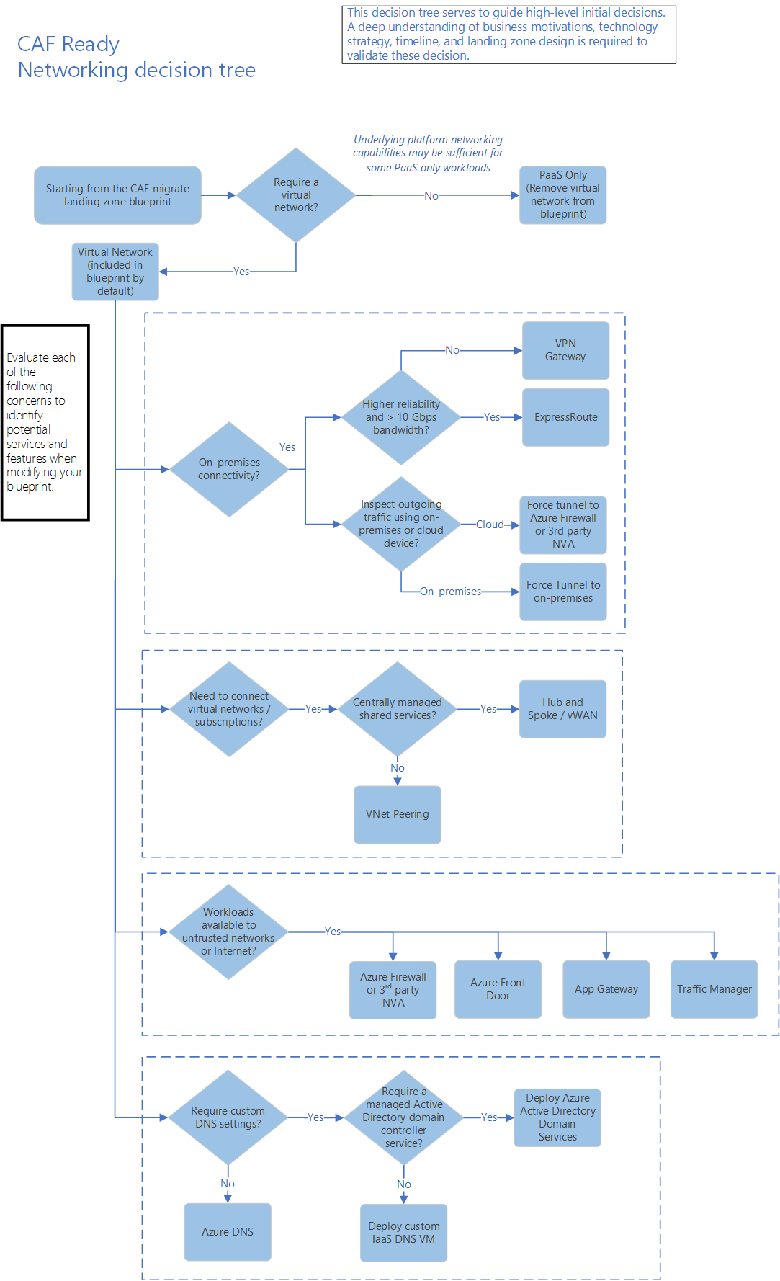
Cloud Adoption Framework Ready – Networking Decision Tree
https://docs.microsoft.com/en-us/azure/cloud-adoption-framework/ready/considerations/networking-options
Notes:
https://docs.microsoft.com/en-us/azure/cloud-adoption-framework/ready/considerations/networking-options

Slide 18
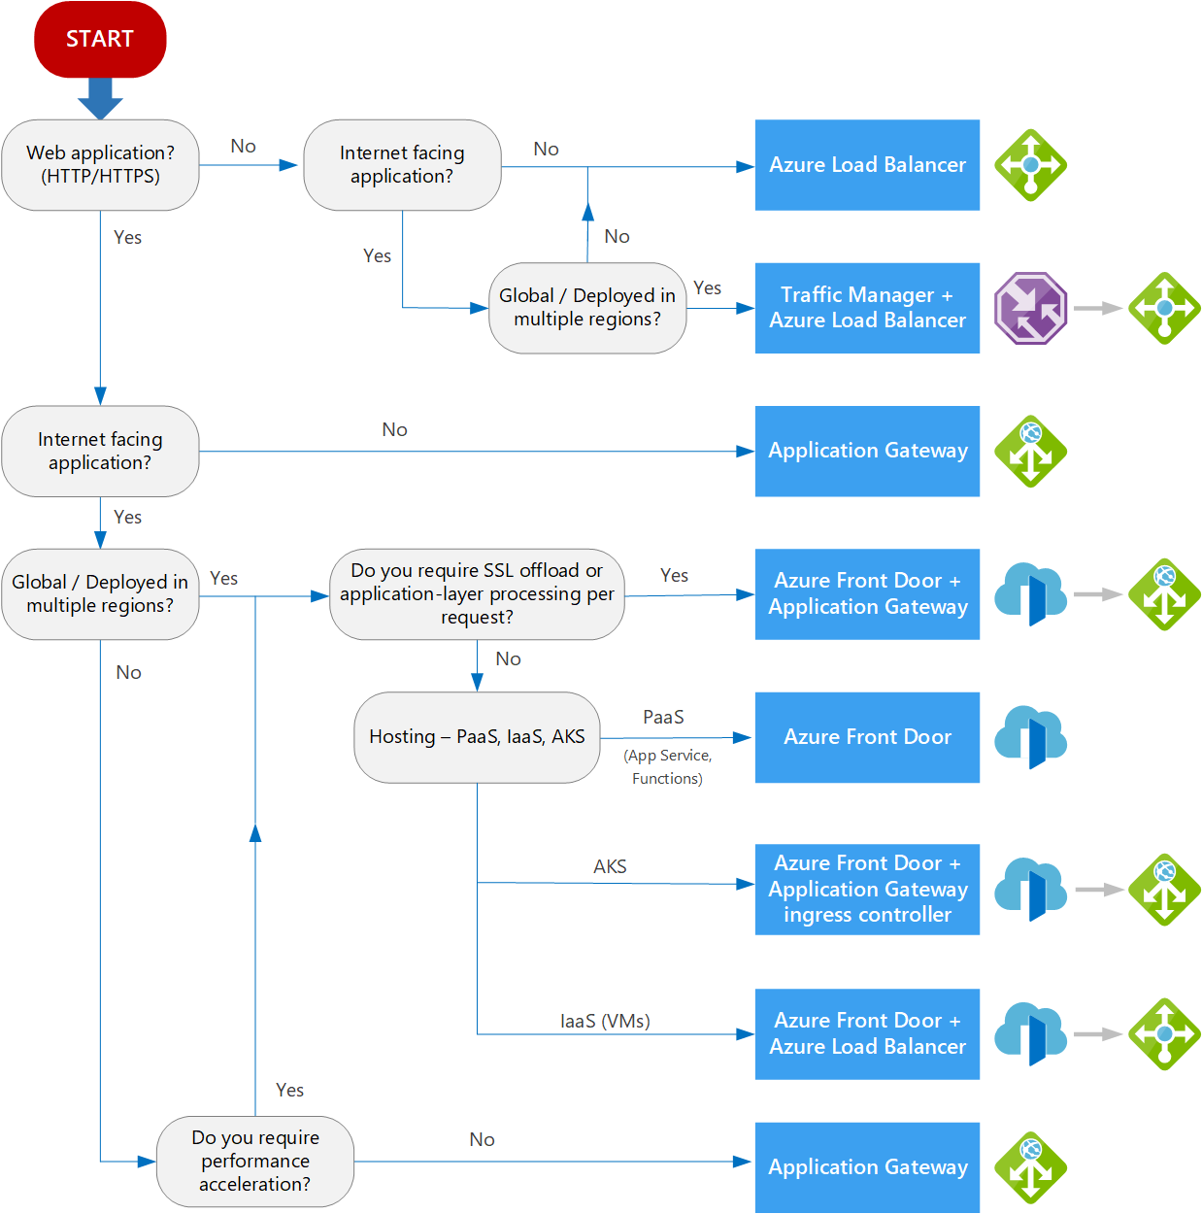
Decision tree for load balancing in Azure
Notes:
https://docs.microsoft.com/en-us/azure/architecture/guide/technology-choices/load-balancing-overview

Slide 19
Security , Identity, Governance and Management

Slide 20
Azure Security, Management and Governance
MIGRATE
Azure Migrate Tool , Azure Site Recovery, and Partner Solutions
GOVERN
SECURE
Policy management with Azure Policy Management
Cost management with Azure Cost Management
Security management with Azure Security Center and Azure Key Vault, Azure Sentinel
Threat protection with Azure ATP
CONFIGURE
Microsoft Azure
PROTECT
Process, Configuration, VM Update management
Automation, Scripting with Azure Automation, DSC and Update Management
BCDR with Azure Site Recovery, Backup with Azure Backup Services
MONITOR
App, Infra & Network monitoring, Log Analytics and Diagnostics with Azure Monitor

Slide 21
Which Security Product To Use?
If You Want To... | Use This
Unify security management and enable advanced threat protection for workloads in the cloud and on-premises | Security Center
Safeguard cryptographic keys and other secrets used by cloud apps and services | Key Vault
Protect your Azure resources from denial of service threats | Azure DDoS Protection
Control and help secure email, documents, and sensitive data that you share outside your company | Azure Information Protection
Protect your applications from common web vulnerabilities and exploits with a built-in web application firewall | Application Gateway
https://azure.microsoft.com/en-us/product-categories/security/

Slide 22
Management and Governance – Which Products to Use?
Management Tools For Monitoring | Use This
Get visibility into the status of Azure platform components | Azure Monitor
Collect, search, and visualize machine data from on-premises and cloud | Log Analytics
Monitor and diagnose network issues | Network Watcher
Management Tools For Configuration | Use This
Automate, configure, and update your resources | Automation
Get personalized recommendations to help manage your Azure environment | Azure Advisor
Deploy and manage your Azure resources | Azure Resource Manager
Create, maintain, and invoke scheduled work for your apps | Scheduler
Route incoming traffic for better performance and availability | Traffic Manager
Manage Azure using a command-line experience | Cloud Shell
Manage deployed solutions for your customers | Azure Managed Applications
Personalize and manage your Azure environment | Microsoft Azure portal
Stay connected to your Azure resources from anywhere at anytime | Azure mobile app
Empowering service providers to manage customers at scale and with precision | Azure Lighthouse

Slide 23
Management and Governance – Which Products to Use?
Management Tools For Governance | Use This
Get transparency into what you are spending on cloud resources | Cost Management + Billing
Set policies across resources and monitor compliance | Azure Policy
Enabling quick, repeatable creation of governed environments | Azure Blueprints
Management Tools For Security And Protection | Use This
Back up your resources and protect against data loss | Azure Backup
Deliver highly available virtual machines with built-in disaster recovery | Azure Site Recovery
Secure your resources and protect against threats | Security Center

Slide 24
Which Feature to Use to Secure Azure Platform
Compliance
Trust Center
Common Controls Hub
The Cloud Services Due Diligence Checklist
Compliance by service, location & Industry
Secure Platform
Security Development Cycle, Internal audits
Mandatory Security training, background checks
Penetration testing, intrusion detection, DDoS, Audits & logging
State of the art data center, physical security, Secure Network
Security Incident response, Shared Responsibility
Privacy & Controls
Manage your data all the time
Control on data location
Provide data access on your terms
Responding to law enforcement
Stringent privacy standards
Transparency
How Microsoft secures customer data in Azure services
How Microsoft manage data location in Azure services
Who in Microsoft can access your data on what terms
How Microsoft secures customer data in Azure services
Review certification for Azure services, Transparency hub

Slide 25
Identity and Access Management – Choosing the Right Product?
If You Want To... | Use This
Provide identity and access management for cloud and hybrid environments | Azure Active Directory
Manage and protect customer identities and access in the cloud using IAM security features | Azure Active Directory B2C
Join virtual machines in Azure to a domain without deploying domain controllers | Azure Active Directory Domain Services

Slide 26
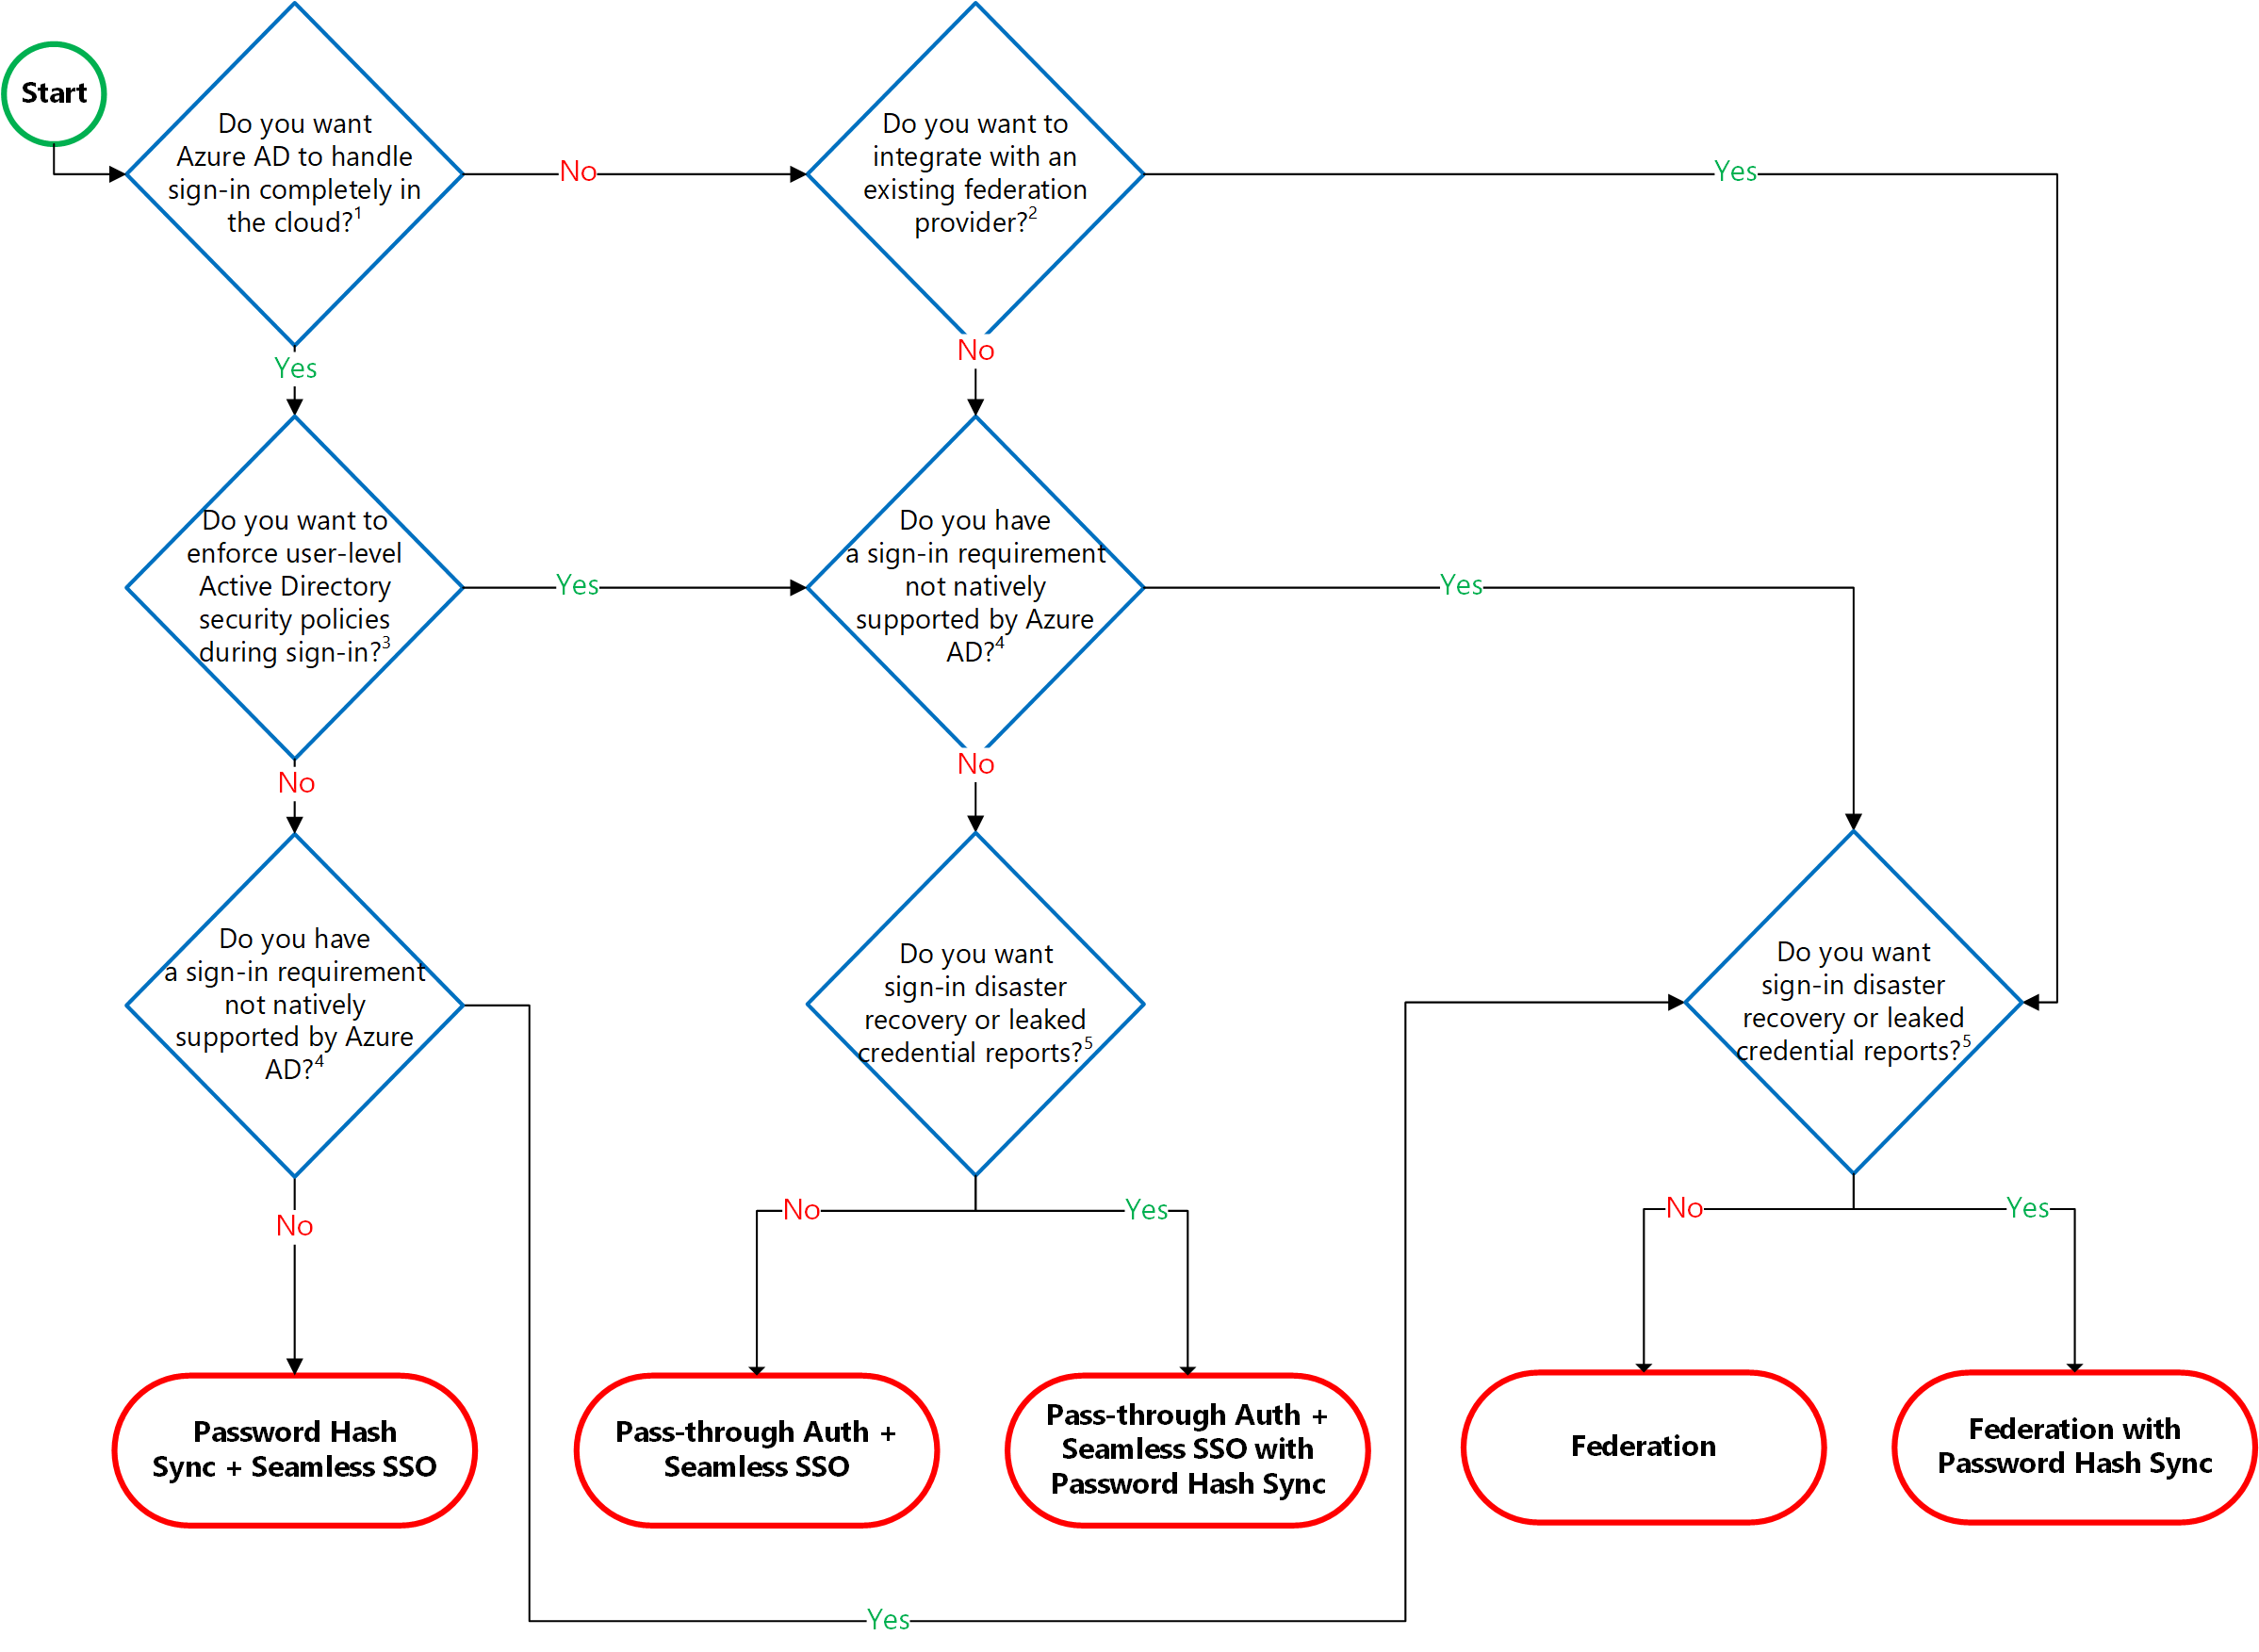
Choosing the Right Authentication Model
Notes:
https://docs.microsoft.com/en-us/azure/active-directory/hybrid/choose-ad-authn
Identity Baseline Tools
https://docs.microsoft.com/en-us/azure/architecture/cloud-adoption/governance/identity-baseline/toolchain
Identity Baseline is one of the Five Disciplines of Cloud Governance. This discipline focuses on ways of establishing policies that ensure consistency and continuity of user identities regardless of the cloud provider that hosts the application or workload.
Selecting Right Auth Model with AAD
https://youtu.be/YtW2cmVqSEw

Slide 27
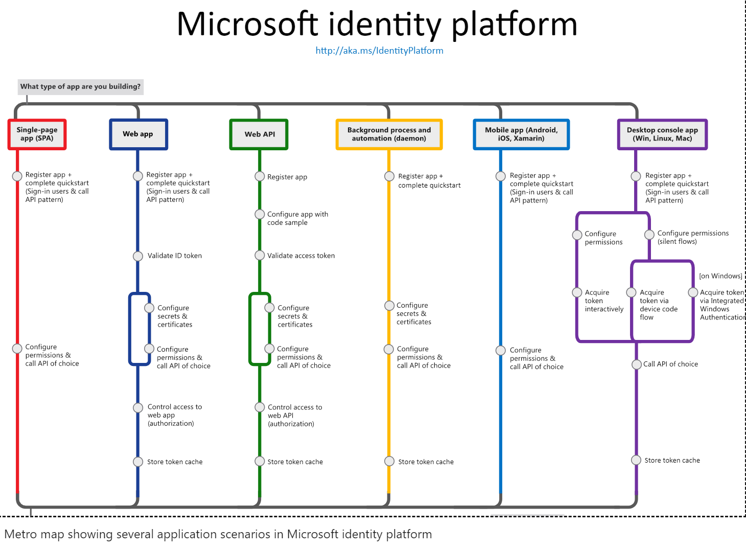

Slide 28
Application Migration/Modernization

Slide 29
Objective | Rehost | Refactor | Rearchitect | Rebuild | Cloud model
Deliver new and breakthrough capabilities faster Optimize for developer productivity, build apps faster |  |  |  |  | PaaS
Enable multichannel access, including mobile and IoT Enable secure access to apps and data, on a wide range of devices |  |  |  |  | PaaS
More easily integrate with other web and cloud apps Leverage PaaS, increase productivity with serverless |  |  |  |  | PaaS
Enable business agility with continuous innovation Increase agility across teams and deliver better software, faster |  |  |  |  | PaaS
Meet scalability requirements of existing apps cost effectively Optimize application architecture for cloud scale |  |  |  |  | PaaS
Leverage existing investments Across DevOps, developer tooling, management, infrastructure and app services |  |  |  |  | PaaS
Free up data center space quickly Free up/consolidate resources for apps that must reside on-premises |  |  |  |  | IaaS
Reduce capital expenditure of existing applications Switch to pay-as-you-go model, realize better budget forecasting |  |  |  |  | IaaS
Achieve rapid time to cloud Allow migration with minimal architectural impact |  |  |  |  | IaaS

Slide 30
Azure Data Platform

Slide 31
Which Azure Database Product To Use?
If You Want... | Use This
Build modern cloud applications with an always up-to-date relational database service that includes serverless compute, hyperscale storage, and AI-powered and automated features to optimize performance and durability | Azure SQL Database
Migrate your SQL workloads to Azure while maintaining complete SQL Server compatibility, with all the benefits of a fully managed and evergreen platform as a service | Azure SQL Managed Instance
Migrate your SQL workloads to Azure while maintaining complete SQL Server compatibility and operating system-level access | SQL Server on Virtual Machines
Build scalable, secure, and fully managed enterprise-ready apps on open-source PostgreSQL, scale out single-node PostgreSQL with high performance, or migrate PostgreSQL and Oracle workloads to the cloud | Azure Database for PostgreSQL
Deliver high availability and elastic scaling to open-source mobile and web apps with a managed community MySQL database service, or migrate MySQL workloads to the cloud | Azure Database for MySQL
Deliver high availability and elastic scaling to open-source mobile and web apps with a managed community MariaDB database service | Azure Database for MariaDB
Build applications with guaranteed low latency and high availability anywhere, at any scale, or migrate Cassandra, MongoDB, and other NoSQL workloads to the cloud | Azure Cosmos DB
Power fast, scalable applications with an open-source-compatible in-memory data store | Azure Cache for Redis
Accelerate your transition to the cloud using a simple, self-guided migration process | Azure Database Migration Service
Notes:
https://azure.microsoft.com/en-us/product-categories/databases/

Slide 32
Data Platform Use Case Scenarios and Comparison
 | Azure SQL Database | Azure SQL Managed Instance | SQL Server on Virtual Machines | Azure Database for PostgreSQL | Azure Database for MySQL | Azure Database for MariaDB | Azure Cosmos DB | Azure Cache for Redis
Relational Database | Available | Available | Available | Available | Available | Available
Non-Relational Database (NoSQL) |  |  |  |  |  |  | Available
In-Memory Database |  |  |  |  |  |  |  | Available
Data Models | Relational | Relational | Relational | Relational | Relational | Relational | Multi-Model: Document Wide-column Key-Value Graph | Key-Value
Hybrid | Available | Available | Available | Available (Hyperscale)
Serverless Compute | Available |  |  |  |  |  | Available
Storage Scale Out | Available (Hyperscale) |  |  | Available (Hyperscale) |  |  | Available | Available
Compute Scale Out | Available (Hyperscale - read-only) |  |  | Available (Hyperscale) |  |  | Available | Available
Distributed Multi-Master Writes (Write data to different regions) |  |  |  |  |  |  | Available | Available (Coming Soon)
OSS Based Service (Community edition and open extension support) |  |  |  | Available | Available | Available |  | Available
HTAP (Available with Azure Synapse Link) | Available (Coming Soon) |  |  | Available (Coming Soon) |  |  | Available

Slide 33
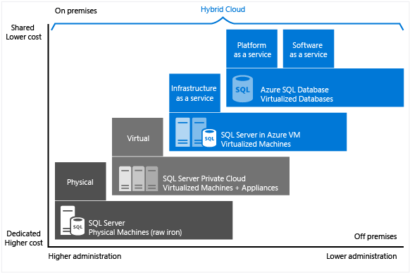
Choose the right SQL Server option in Azure
Choose the right SQL Server option in Azure

Slide 34
Choose the right SQL Server option in Azure
SQL Server on VM | Managed instance in SQL Database | Single database / elastic pool in SQL Database
You have full control over the SQL Server engine. Up to 99.95% availability. Full parity with the matching version of on-premises SQL Server. Fixed, well-known database engine version. Easy migration from SQL Server on-premises Private IP address within Azure Vnet You have ability to deploy application or services on the host where SQL Server is placed | High compatibility with SQL Server on-premises 99.99% availability guaranteed Built-in backups, patching, recovery Latest stable Database Engine version Easy migration from SQL Server Private IP address within Azure Vnet Built-in advanced intelligence and security Online change of resources (CPU/storage). | The most commonly used SQL Server features are available 99.99% availability guaranteed Built-in backups, patching, recovery Latest stable Database Engine version Ability to assign necessary resources (CPU/storage) to individual databases Built-in advanced intelligence and security Online change of resources (CPU/storage).
You need to manage your backups and patches You need to implement your own High-Availability solution There is a downtime while changing the resources(CPU/storage) | There is still some minimal number of SQL Server features that are No guaranteed exact maintenance time (but nearly transparent) Compatibility with the SQL Server version can be achieved only using database compatibility levels. | Migration from SQL Server might be hard Some SQL Server features are No guaranteed exact maintenance time (but nearly transparent) Compatibility with the SQL Server version can be achieved only using database compatibility levels Private IP address cannot be assigned (you can limit the access using firewall rules).
https://docs.microsoft.com/en-us/azure/sql-database/sql-database-paas-vs-sql-server-iaas#business-motivations-for-choosing-azure-sql-database-or-sql-server-on-azure-vms

Slide 35
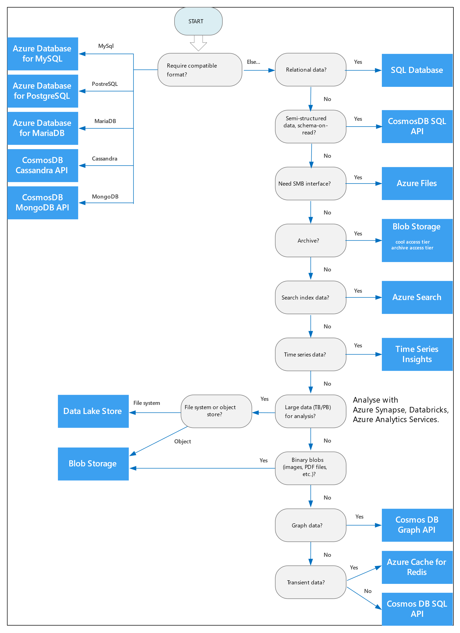
Select an Azure data store for your application
Notes:
https://docs.microsoft.com/en-us/azure/architecture/guide/technology-choices/data-store-decision-tree
Azure offers a number of managed data storage solutions, each providing different features and capabilities. This article will help you to choose a data store for your application.
If your application consists of multiple workloads, evaluate each workload separately. A complete solution may incorporate multiple data stores.
Use the following flowchart to select a candidate data store.
https://docs.microsoft.com/en-us/azure/architecture/guide/technology-choices/data-store-decision-tree

Slide 36
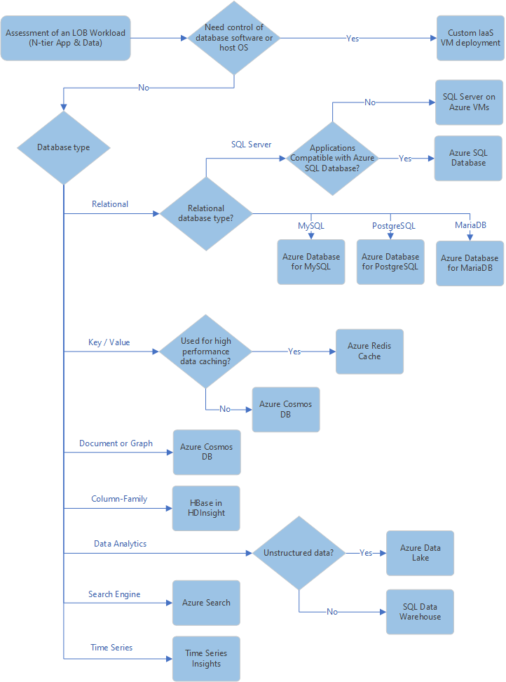
Select an Azure data store for your application

Slide 37
Migration Tools

Slide 38
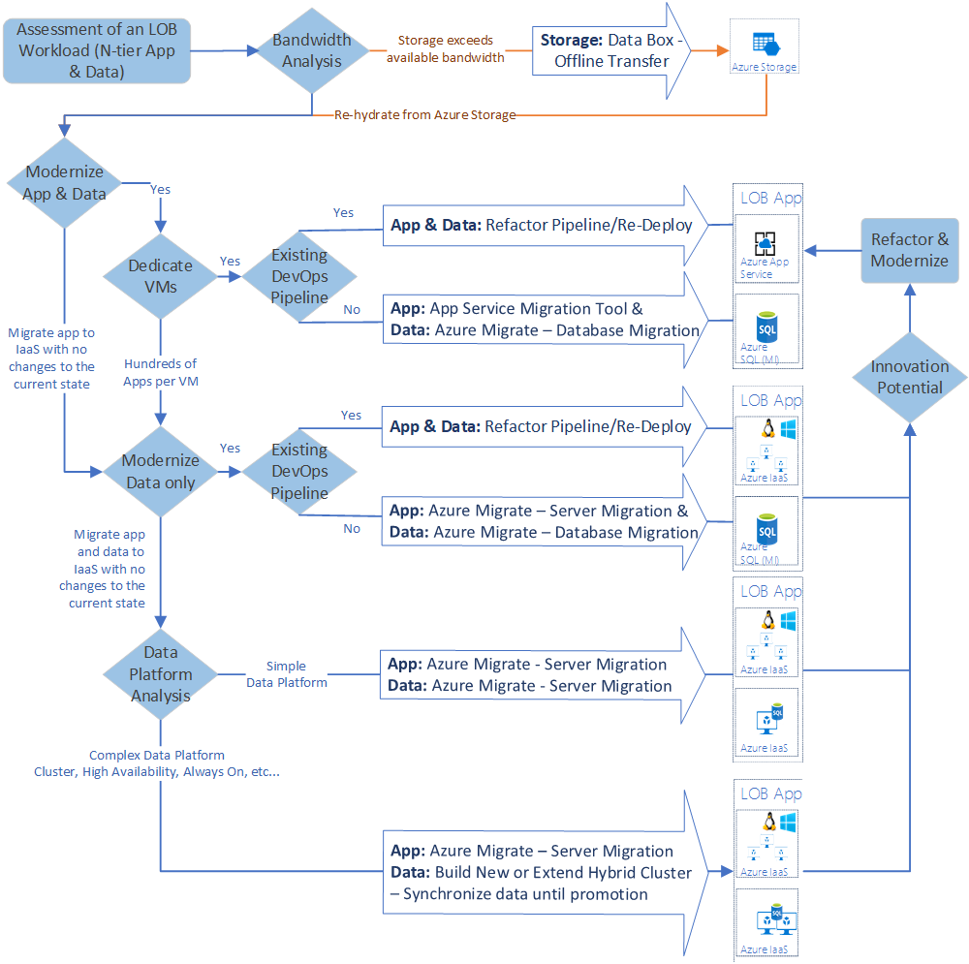
Migration tools decision guide

Slide 39
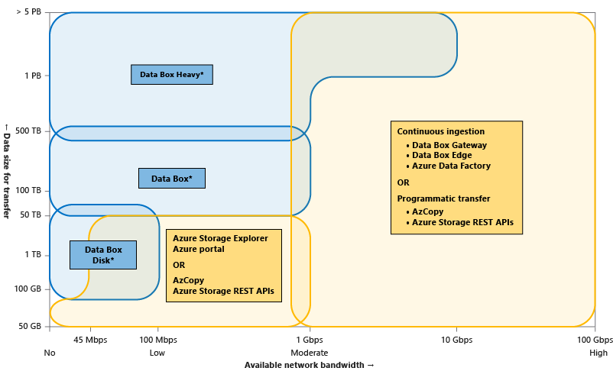
Choose the various Azure data transfer tools

Slide 40
Selecting the Right Offline Data Transfer Solutions
 | Data Box Disk | Data Box | Data Box Heavy | Import/Export
Data size | Up to 35 TBs | Up to 80 TBs per device | Up to 800 TB per device | Variable
Data type | Azure Blobs | Azure Blobs Azure Files | Azure Blobs Azure Files | Azure Blobs Azure Files
Form factor | 5 SSDs per order | 1 X 50-lbs. desktop-sized device per order | 1 X ~500-lbs. large device per order | Up to 10 HDDs/SSDs per order
Initial setup time | Low (15 mins) | Low to moderate (<30 mins) | Moderate (1-2 hours) | Moderate to difficult (variable)
Send data to Azure | Yes | Yes | Yes | Yes
Export data from Azure | No | No | No | Yes
Encryption | AES 128-bit | AES 256-bit | AES 256-bit | AES 128-bit
Hardware | Microsoft supplied | Microsoft supplied | Microsoft supplied | Customer supplied
Network interface | USB 3.1/SATA | RJ 45, SFP+ | RJ45, QSFP+ | SATA II/SATA III
Partner integration | Some | High | High | Some
Shipping | Microsoft managed | Microsoft managed | Microsoft managed | Customer managed
Use when data moves | Within a commerce boundary | Within a commerce boundary | Within a commerce boundary | Across geographic boundaries, e.g. US to EU
https://docs.microsoft.com/en-us/azure/storage/common/storage-solution-large-dataset-moderate-high-network

Slide 41
Selecting the Right Online Data Transfer Solutions
 | Tools AzCopy, Azure PowerShell, Azure CLI | Azure Storage REST APIs, SDKs | Data Box Gateway or Data Box Edge | Azure Data Factory
Data type | Azure Blobs, Azure Files, Azure Tables | Azure Blobs, Azure Files, Azure Tables | Azure Blobs, Azure Files | Supports 70+ data connectors for data stores and formats
Form factor | Command-line tools | Programmatic interface | Microsoft supplies a virtual or physical device | Service in Azure portal
Initial one-time setup | Easy | Moderate | Easy (<30 minutes) to moderate (1-2 hours) | Extensive
Data pre-processing | No | No | Yes (With Edge compute) | Yes
Transfer from other clouds | No | No | No | Yes
User type | IT Pro or dev | Dev | IT Pro | IT Pro
https://docs.microsoft.com/en-us/azure/storage/common/storage-solution-large-dataset-moderate-high-network

Slide 42
Selecting the Right Tool for Database Migration to Azure
Tool | Description
Configuration Manager | Use SQL Server Configuration Manager to configure SQL Server services and configure network connectivity. Configuration Manager runs on Windows
Database Experimentation Assistant | Use Database Experimentation Assistant to evaluate a targeted version of SQL for a given workload.
Data Migration Assistant | The Data Migration Assistant tool helps you upgrade to a modern data platform by detecting compatibility issues that can impact database functionality in your new version of SQL Server or Azure SQL Database.
Distributed Replay | Use the Distributed Replay feature to help you assess the impact of future SQL Server upgrades. Also use Distributed Replay to help assess the impact of hardware and operating system upgrades, and SQL Server tuning.
SQL Server Migration Assistant | Use SQL Server Migration Assistant to automate database migration to SQL Server from Microsoft Access, DB2, MySQL, Oracle, and Sybase.

Slide 43
Useful Links
Azure Introduction – Tenants, Subscriptions, Guidance on Naming Conventions, IP Addressing, Important facts to understand before planning your virtual DC
Getting started with Microsoft Azure security – How Azure Stores Customer Info in various PaaS, IaaS and other scenarios
Azure subscription and service limits, quotas, and constraints
List of supported software on Azure
Azure Pricing Calculator (Channel Partners, Customers)
Monitoring
Sources of monitoring data in Azure
Collecting monitoring data in Azure
Multi-customer monitoring with Azure Log Analytics (MSPs/Service Providers)
*Refer to the notes section for important facts on Azure , will be useful for planning your virtual DC
Notes:
Mesh and Hub-and-Spoke Networks on Azure: Architectural Considerations for Virtual Network Peering
Microsoft Azure Datacenter IP Ranges Microsoft Public IP Space Network infrastructure requirements for Microsoft Intune Power BI and ExpressRoute Office 365 URLs and IP address ranges Managing ExpressRoute for Office 365 connectivity Office 365 Network Connectivity Principles
Managing Office 365 End Points: https://support.office.com/en-us/article/managing-office-365-endpoints-99cab9d4-ef59-4207-9f2b-3728eb46bf9a?ui=en-US&rs=en-US&ad=US#ID0EACAAA=0._Overview

Slide 44
Update Log
Last Updated: 02 Sep 2019
Reviewed and Updated product slides for IaaS
New Slides
Slide 11 - Storage Durability
Slide 15 - Choose the right virtual networking architectures
Slide 27: Choosing a Data Store
Slide 28 - 32: Azure Data Migration Tools

Slide 45
Update Log
Last Updated 26 Mar 2019
Reviewed and updated slides for IaaS
Added Azure Data Platform as a separate section
Updated Networking section
Updated Management, Monitoring and Governance section
New Slides
Slide 9 – Selection Criteria for DevOps workloads
Slide 17 – Load Balancer Decision Tree (Thanks to @mvark – github)
Slide 30 – Updated Decision Tree for Azure Migration Tool
Slide 35 – SQL Server Migration to Azure – Tools
Slide 38 – Azure Messaging Services
Notes:
https://docs.microsoft.com/en-in/azure/azure-monitor/overview

